Slide 1
Objectives
In this session, you will learn to:
Retrieve data

Slide 2
Retrieving Specific Attributes
The SELECT statement is used for accessing and retrieving data from a database.
Syntax:
SELECT [ALL | DISTINCT] select_column_list [INTO [new_table_name]] [FROM {table_name | view_name} [WHERE search_condition]
Notes:
You can summarize the session by running through the summary given in SG.
In addition, you can also ask students summarize what they have learnt in this session.

Slide 3
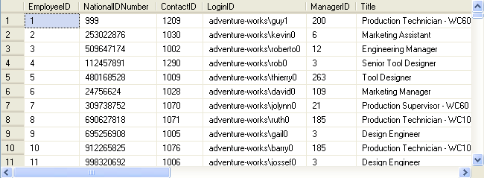
Retrieving Specific Attributes (Contd.)
To display all the details of employees, you can use the following query:
SELECT * FROM HumanResources.Employee
Output
Notes:
Student already have learnt about type 2 SCDs in Module I. Therefore, you can start this topic by asking the following questions to students:
What are type 2 SCDs?
Given an example to explain type 2 SCDs.
This will recapitulate what they have learnt about type 2 SCD in Module 1.
Now explain the strategy to update the data into these dimension tables with help the example given in SG.
After explaining the examples, you can ask students to think of an example of a type 2 SCD and then tell the strategy to update the data into this dimension table.

Slide 4
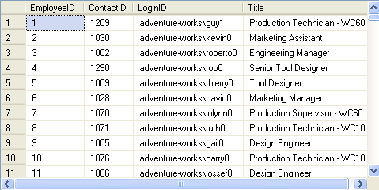
Retrieving Specific Attributes (Contd.)
To view specific details, you can specify the column names in the SELECT statement, as shown in the following query:
SELECT EmployeeID, ContactID, LoginID, Title
FROM HumanResources.Employee
Output
Notes:
Student already have learnt about type 2 SCDs in Module I. Therefore, you can start this topic by asking the following questions to students:
What are type 2 SCDs?
Given an example to explain type 2 SCDs.
This will recapitulate what they have learnt about type 2 SCD in Module 1.
Now explain the strategy to update the data into these dimension tables with help the example given in SG.
After explaining the examples, you can ask students to think of an example of a type 2 SCD and then tell the strategy to update the data into this dimension table.

Slide 5
Retrieving Specific Attributes (Contd.)
Customizing the display:
Consider the following example that displays the Department ID and Department Names from the Department table of the AdventureWorks database.
The report should contain column headings different from those given in the table, as shown in the following figure.
Department Number | Department Name
Notes:
Student already have learnt about type 2 SCDs in Module I. Therefore, you can start this topic by asking the following questions to students:
What are type 2 SCDs?
Given an example to explain type 2 SCDs.
This will recapitulate what they have learnt about type 2 SCD in Module 1.
Now explain the strategy to update the data into these dimension tables with help the example given in SG.
After explaining the examples, you can ask students to think of an example of a type 2 SCD and then tell the strategy to update the data into this dimension table.

Slide 6
Retrieving Specific Attributes (Contd.)
You can write the query in the following ways:
SELECT 'Department Number'= DepartmentID, 'Department Name'= Name FROM HumanResources.Department
SELECT DepartmentID 'Department Number', Name 'Department Name' FROM HumanResources.Department
SELECT DepartmentID AS 'Department Number', Name AS 'Department Name' FROM HumanResources.Department
OR
OR
Notes:
Student already have learnt about type 2 SCDs in Module I. Therefore, you can start this topic by asking the following questions to students:
What are type 2 SCDs?
Given an example to explain type 2 SCDs.
This will recapitulate what they have learnt about type 2 SCD in Module 1.
Now explain the strategy to update the data into these dimension tables with help the example given in SG.
After explaining the examples, you can ask students to think of an example of a type 2 SCD and then tell the strategy to update the data into this dimension table.

Slide 7
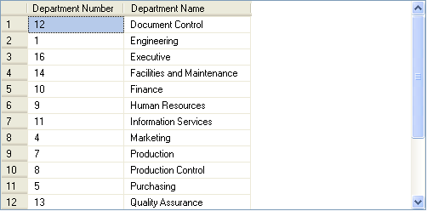
Retrieving Specific Attributes (Contd.)
The SQL Server will display the same output for all the preceding queries, as shown in the following figure.
Notes:
Student already have learnt about type 2 SCDs in Module I. Therefore, you can start this topic by asking the following questions to students:
What are type 2 SCDs?
Given an example to explain type 2 SCDs.
This will recapitulate what they have learnt about type 2 SCD in Module 1.
Now explain the strategy to update the data into these dimension tables with help the example given in SG.
After explaining the examples, you can ask students to think of an example of a type 2 SCD and then tell the strategy to update the data into this dimension table.

Slide 8
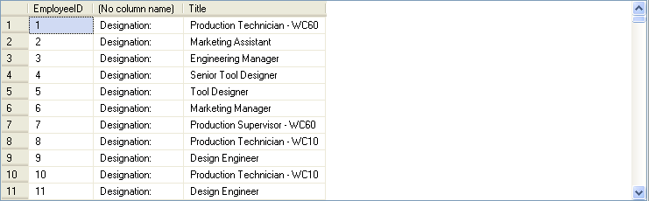
Retrieving Specific Attributes (Contd.)
Literals are string values that are enclosed in single quotes and added to the SELECT statement.
The following SQL query retrieves the employee ID and their titles from the Employee table along with a literal ‘Designation’:
SELECT EmployeeID, 'Designation: ', Title
FROM HumanResources.Employee
Output
Notes:
Student already have learnt about type 2 SCDs in Module I. Therefore, you can start this topic by asking the following questions to students:
What are type 2 SCDs?
Given an example to explain type 2 SCDs.
This will recapitulate what they have learnt about type 2 SCD in Module 1.
Now explain the strategy to update the data into these dimension tables with help the example given in SG.
After explaining the examples, you can ask students to think of an example of a type 2 SCD and then tell the strategy to update the data into this dimension table.

Slide 9
Retrieving Specific Attributes (Contd.)
Concatenating the text values in the output:
The concatenation operator is used to concatenate string expressions and is represented by the + sign.
To concatenate two strings, you can use the following query:
SELECT 'snow' + 'ball'
Output
snowball
Notes:
Student already have learnt about type 2 SCDs in Module I. Therefore, you can start this topic by asking the following questions to students:
What are type 2 SCDs?
Given an example to explain type 2 SCDs.
This will recapitulate what they have learnt about type 2 SCD in Module 1.
Now explain the strategy to update the data into these dimension tables with help the example given in SG.
After explaining the examples, you can ask students to think of an example of a type 2 SCD and then tell the strategy to update the data into this dimension table.

Slide 10
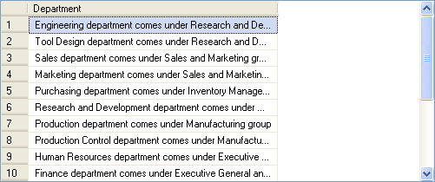
Retrieving Specific Attributes (Contd.)
The following SQL query concatenates the data of the Name and GroupName columns of the Department table into a single column:
SELECT Name + ' department comes under ‘ + GroupName + ' group' AS Department FROM HumanResources.Department
Output
Notes:
Student already have learnt about type 2 SCDs in Module I. Therefore, you can start this topic by asking the following questions to students:
What are type 2 SCDs?
Given an example to explain type 2 SCDs.
This will recapitulate what they have learnt about type 2 SCD in Module 1.
Now explain the strategy to update the data into these dimension tables with help the example given in SG.
After explaining the examples, you can ask students to think of an example of a type 2 SCD and then tell the strategy to update the data into this dimension table.

Slide 11
Retrieving Specific Attributes (Contd.)
Calculating column values:
Arithmetic operators are used to perform mathematical operations, such as addition, subtraction, division, and multiplication, on numeric columns or on numeric constants.
SQL Server supports the following arithmetic operations:
+ (for addition)
- (for subtraction)
/ (for division)
* (for multiplication)
% (for modulo)
Notes:
Student already have learnt about type 2 SCDs in Module I. Therefore, you can start this topic by asking the following questions to students:
What are type 2 SCDs?
Given an example to explain type 2 SCDs.
This will recapitulate what they have learnt about type 2 SCD in Module 1.
Now explain the strategy to update the data into these dimension tables with help the example given in SG.
After explaining the examples, you can ask students to think of an example of a type 2 SCD and then tell the strategy to update the data into this dimension table.

Slide 12
Retrieving Specific Attributes (Contd.)
The following SQL query retrieves the per day rate of the employees from the EmployeePayHistory table: SELECT EmployeeID, Rate,
Per_Day_Rate = 8 * Rate
FROM HumanResources.EmployeePayHistory
Rate is multiplied by 8, assuming that an employee works for eight hours in a day.
Notes:
Student already have learnt about type 2 SCDs in Module I. Therefore, you can start this topic by asking the following questions to students:
What are type 2 SCDs?
Given an example to explain type 2 SCDs.
This will recapitulate what they have learnt about type 2 SCD in Module 1.
Now explain the strategy to update the data into these dimension tables with help the example given in SG.
After explaining the examples, you can ask students to think of an example of a type 2 SCD and then tell the strategy to update the data into this dimension table.

Slide 13
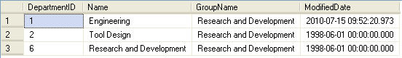
Retrieving Selected Rows
Selected rows can be retrieved using the WHERE clause in the SELECT statement.
The following SQL query retrieves the department details from the Department table, where the group name is Research and Development:
SELECT * FROM HumanResources.Department
WHERE GroupName = 'Research and Development'
Output
Notes:
Student already have learnt about type 2 SCDs in Module I. Therefore, you can start this topic by asking the following questions to students:
What are type 2 SCDs?
Given an example to explain type 2 SCDs.
This will recapitulate what they have learnt about type 2 SCD in Module 1.
Now explain the strategy to update the data into these dimension tables with help the example given in SG.
After explaining the examples, you can ask students to think of an example of a type 2 SCD and then tell the strategy to update the data into this dimension table.

Slide 14
Retrieving Selected Rows (Contd.)
Comparison operators:
Test for similarity between two expressions.
Allow row retrieval from a table based on the condition specified in the WHERE clause.
Cannot be used on text, ntext, or image data type expressions.
Syntax:
SELECT column_list
FROM table_name
WHERE expression1 comparison_operator expression2
Notes:
Student already have learnt about type 2 SCDs in Module I. Therefore, you can start this topic by asking the following questions to students:
What are type 2 SCDs?
Given an example to explain type 2 SCDs.
This will recapitulate what they have learnt about type 2 SCD in Module 1.
Now explain the strategy to update the data into these dimension tables with help the example given in SG.
After explaining the examples, you can ask students to think of an example of a type 2 SCD and then tell the strategy to update the data into this dimension table.

Slide 15
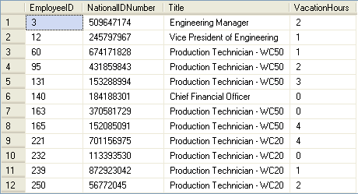
Retrieving Selected Rows (Contd.)
The following SQL query retrieves records from the Employee table where the vacation hour is less than 5:
SELECT EmployeeID, NationalIDNumber, Title, VacationHours FROM HumanResources.Employee WHERE VacationHours < 5
Output
Notes:
Student already have learnt about type 2 SCDs in Module I. Therefore, you can start this topic by asking the following questions to students:
What are type 2 SCDs?
Given an example to explain type 2 SCDs.
This will recapitulate what they have learnt about type 2 SCD in Module 1.
Now explain the strategy to update the data into these dimension tables with help the example given in SG.
After explaining the examples, you can ask students to think of an example of a type 2 SCD and then tell the strategy to update the data into this dimension table.

Slide 16
Retrieving Selected Rows (Contd.)
Logical operators:
Are used in the SELECT statement to retrieve records based on one or more conditions.
Are of the following types:
OR
AND
NOT
Syntax:
SELECT column_list
FROM table_name
WHERE conditional_expression1 {AND/OR} [NOT]
conditional_expression2
Notes:
Student already have learnt about type 2 SCDs in Module I. Therefore, you can start this topic by asking the following questions to students:
What are type 2 SCDs?
Given an example to explain type 2 SCDs.
This will recapitulate what they have learnt about type 2 SCD in Module 1.
Now explain the strategy to update the data into these dimension tables with help the example given in SG.
After explaining the examples, you can ask students to think of an example of a type 2 SCD and then tell the strategy to update the data into this dimension table.

Slide 17
Retrieving Selected Rows (Contd.)
For example:
SELECT * FROM HumanResources.Department
WHERE GroupName = 'Manufacturing'
OR GroupName = ' Quality Assurance'
Retrieves records from the Department table when the GroupName is either Manufacturing or Quality Assurance.
Notes:
Student already have learnt about type 2 SCDs in Module I. Therefore, you can start this topic by asking the following questions to students:
What are type 2 SCDs?
Given an example to explain type 2 SCDs.
This will recapitulate what they have learnt about type 2 SCD in Module 1.
Now explain the strategy to update the data into these dimension tables with help the example given in SG.
After explaining the examples, you can ask students to think of an example of a type 2 SCD and then tell the strategy to update the data into this dimension table.

Slide 18
Retrieving Selected Rows (Contd.)
Range operator:
Retrieves data based on a range.
Are of the following types:
BETWEEN
NOT BETWEEN
Syntax:
SELECT column_list
FROM table_name
WHERE expression1 range_operator expression2 AND expression3
For example:
SELECT EmployeeID, VacationHours FROM HumanResources.Employee WHERE VacationHours BETWEEN 20 AND 50
Retrieves records of employees whose vacation hours are not between 40 and 50.
Notes:
Student already have learnt about type 2 SCDs in Module I. Therefore, you can start this topic by asking the following questions to students:
What are type 2 SCDs?
Given an example to explain type 2 SCDs.
This will recapitulate what they have learnt about type 2 SCD in Module 1.
Now explain the strategy to update the data into these dimension tables with help the example given in SG.
After explaining the examples, you can ask students to think of an example of a type 2 SCD and then tell the strategy to update the data into this dimension table.

Slide 19
Just a minute
Which of the following options are logical operators?
1. BETWEEN and NOT BETWEEN
2. AND, OR, and NOT
3. + and %
4. > and <
Answer:
2. AND, OR, and NOT

Slide 20
Retrieving Selected Rows (Contd.)
IN keyword:
Selects values that match any one of the values in a list.
NOT IN keyword:
Restricts the selection of values that match any one of the values in a list.
Syntax:
SELECT column_list
FROM table_name
WHERE expression list_operator (‘value_list’)
For example:
SELECT EmployeeID, Title, LoginID FROM HumanResources.Employee WHERE Title IN ('Recruiter', 'Stocker')
Retrieves records of employees who are Recruiter or Stocker from the Employee table.
Notes:
Example: (IN)
SELECT EmployeeID,Title, LoginID FROM HumanResources.Employee WHERE Title IN ('Recruiter', 'Stocker')
Example: (NOT IN)
SELECT EmployeeID,Title, LoginID FROM HumanResources.Employee WHERE Title NOT IN ('Recruiter', 'Stocker')

Slide 21
Retrieving Selected Rows (Contd.)
The LIKE keyword:
Is used to search a string by using the following wildcard characters:
%
_
[]
[^] – should not start with a to s [^A-S]
Matches the given character string with the specified pattern.
For example:
SELECT * FROM HumanResources.Department WHERE Name LIKE 'Pro%'
Retrieves records from the Department table where the values of Name column begin with ‘Pro’.
Notes:
Example: (IN)
SELECT EmployeeID,Title, LoginID FROM HumanResources.Employee WHERE Title IN ('Recruiter', 'Stocker')
Example: (NOT IN)
SELECT EmployeeID,Title, LoginID FROM HumanResources.Employee WHERE Title NOT IN ('Recruiter', 'Stocker')

Slide 22
Retrieving Selected Rows (Contd.)
NULL values:
Can be retrieved by using the IS NULL keyword with the SELECT statement.
Syntax:
SELECT column_list FROM table_name WHERE column_name unknown_value_operator
For example:
SELECT EmployeeID, EndDate FROM HumanResources.EmployeeDepartmentHistory WHERE EndDate IS NULL
Retrieves only those rows from the EmployeeDepartmentHistory table for which value in the EndDate column is NULL.
Notes:
Example: (IN)
SELECT EmployeeID,Title, LoginID FROM HumanResources.Employee WHERE Title IN ('Recruiter', 'Stocker')
Example: (NOT IN)
SELECT EmployeeID,Title, LoginID FROM HumanResources.Employee WHERE Title NOT IN ('Recruiter', 'Stocker')

Slide 23
Retrieving Selected Rows (Contd.)
ORDER BY clause:
Can be used with the SELECT statement to display records in a specific order.
Displays record in ascending or descending order.
Syntax:
SELECT select_list
FROM table_name
[ORDER BY order_by_expression [ASC|DESC]
[, order_by_expression [ASC|DESC]…]
Notes:
Explain the students that when the ORDER BY clause is used, only the output of the SELECT statement is sorted. Stress on that the physical data in the table remains as it is, only the output is sorted. In addition, mention that the default sort order is ASC.
Additional Inputs
Image, text, and ntext columns cannot be used in an ORDER BY clause.
Example: (ASC)
SELECT DepartmentID, Name FROM HumanResources.Department ORDER BY Name ASC

Slide 24
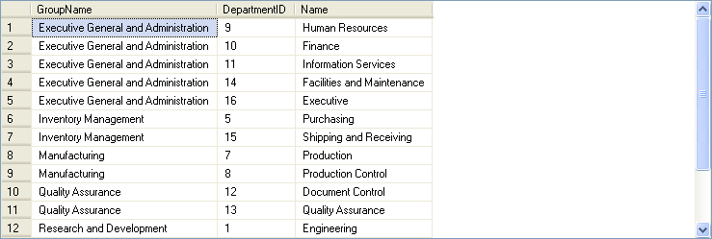
Retrieving Selected Rows (Contd.)
For example:
SELECT GroupName, DepartmentID, Name FROM HumanResources.Department ORDER BY GroupName, DepartmentID
Output
Notes:
Explain the students that when the ORDER BY clause is used, only the output of the SELECT statement is sorted. Stress on that the physical data in the table remains as it is, only the output is sorted. In addition, mention that the default sort order is ASC.
Additional Inputs
Image, text, and ntext columns cannot be used in an ORDER BY clause.
Example: (ASC)
SELECT DepartmentID, Name FROM HumanResources.Department ORDER BY Name ASC

Slide 25
Retrieving Selected Rows (Contd.)
TOP keyword:
Can be used with the SELECT statement to retrieve only the first set of rows from the top of a table.
Syntax:
SELECT [TOP n [PERCENT]] column_name
[,column_name…]
FROM table_name
WHERE search_conditions
[ORDER BY [column_name[,column_name…]
For example:
SELECT TOP 10 * FROM HumanResources.Employee
Retrieves the top 10 rows of the Employee table.
Notes:
Stress that the TOP keyword is used to retrieve the top few records, as they exist in the table. If you require the top few records with respect to a sort order of a particular column, then you need to include the ORDER BY keywords in the SELECT statement.
Additional Input
Unlike previous versions of Microsoft SQL Server, now TOP keyword can also be used with DML statements, such as UPDATE or DELETE.
Example:
SELECT TOP 3 * FROM HumanResources.Employee WHERE HireDate >= '1/1/98' AND HireDate <= '12/31/98' ORDER BY SickLeaveHours ASC

Slide 26
Retrieving Selected Rows (Contd.)
DISTINCT keyword:
Eliminates the duplicate rows from the result set.
Syntax:
SELECT [ALL|DISTINCT] column_names
FROM table_name
WHERE search_condition
For example:
SELECT DISTINCT Title FROM
HumanResources.Employee
WHERE Title LIKE 'PR%'
Retrieves all the titles beginning with PR from the Employee table.
Notes:
Explain the students that when you use more than one column with the DISTINT clause, SQL Server displays you the unique matches of these columns.
Additional Inputs
When using DISTINCT, only the name of a column can be used, an arithmetic expression gives an error.
Example:
SELECT DISTINCT Title FROM HumanResources.Employee WHERE Title LIKE 'PR%'

Slide 27
Just a minute
Write a query to display all the records of the ProductModel table where the product name begins with HL.
Solution:
SELECT * FROM Production.ProductModel WHERE Name LIKE 'HL%'
Notes:
Student already have learnt about type 2 SCDs in Module I. Therefore, you can start this topic by asking the following questions to students:
What are type 2 SCDs?
Given an example to explain type 2 SCDs.
This will recapitulate what they have learnt about type 2 SCD in Module 1.
Now explain the strategy to update the data into these dimension tables with help the example given in SG.
After explaining the examples, you can ask students to think of an example of a type 2 SCD and then tell the strategy to update the data into this dimension table.

Slide 28
Demo: Retrieving Data
Problem Statement:
You are a database developer of AdventureWorks, Inc. The AdventureWorks database is stored in the SQLSERVER01 database server. The details of the sales persons are stored in the SalesPerson table. The management wants to view the details of the top three sales persons who have earned bonus money between $ 4,000 and $ 6,000.
How will you generate this report?
Notes:
Student already have learnt about type 2 SCDs in Module I. Therefore, you can start this topic by asking the following questions to students:
What are type 2 SCDs?
Given an example to explain type 2 SCDs.
This will recapitulate what they have learnt about type 2 SCD in Module 1.
Now explain the strategy to update the data into these dimension tables with help the example given in SG.
After explaining the examples, you can ask students to think of an example of a type 2 SCD and then tell the strategy to update the data into this dimension table.

Slide 29
Demo: Retrieving Data (Contd.)
Solution:
To solve the preceding problem, you need to perform the following tasks:
1. Create a query.
2. Execute the query to generate the report.
Notes:
Student already have learnt about type 2 SCDs in Module I. Therefore, you can start this topic by asking the following questions to students:
What are type 2 SCDs?
Given an example to explain type 2 SCDs.
This will recapitulate what they have learnt about type 2 SCD in Module 1.
Now explain the strategy to update the data into these dimension tables with help the example given in SG.
After explaining the examples, you can ask students to think of an example of a type 2 SCD and then tell the strategy to update the data into this dimension table.

Slide 30
Summary
In this session, you learned that:
Data can be retrieved from a database by using the SELECT statement.
Data of all the columns of a table can be retrieved by specifying * in the SELECT statement.
Data that has to be retrieved based on a condition is specified by adding the WHERE clause.
Literals and user-defined headings are added to change the display.
The concatenation operator is used to concatenate a string expression.
Arithmetic operators are used to perform mathematical operations.
Comparison operators test the similarity between two expressions.
Notes:
You can summarize the session by running through the summary given in SG.
In addition, you can also ask students summarize what they have learnt in this session.

Slide 31
Summary (Contd.)
Logical operators are used in the SELECT statement to retrieve records based on one or matching conditions. The logical operators are AND, OR, and NOT.
Range operators retrieve data based on the range. There are of two types of range operators, BETWEEN and NOT BETWEEN.
The IN keyword allows the selection of values that match any one of the values in a list.
The NOT IN keyword restricts the selection of values that match any one of the values in a list.
The LIKE keyword is used to specify the pattern search.
The IS NULL keyword is used to retrieve missing values.
The ORDER BY clause is used to retrieve data in a specific order.
Notes:
You can summarize the session by running through the summary given in SG.
In addition, you can also ask students summarize what they have learnt in this session.

Slide 32
Summary (Contd.)
The TOP keyword retrieves only the first set of rows, which can either be a number or a percent of rows that will be returned from a query result.
The DISTINCT keyword eliminates duplicate rows.
Notes:
You can summarize the session by running through the summary given in SG.
In addition, you can also ask students summarize what they have learnt in this session.

